Slide 1
Structured Linear Model
Hung-yi Lee

Slide 2
Structured Linear Model
Problem 1: Evaluation
Problem 2: Inference
Problem 3: Training
What does F(x,y) look like?
Given training data, how to find F(x,y)
How to solve the “arg max” problem
in a specific form
Notes:
in a specific form 以特定的形式

Slide 3
Structured Linear Model: Problem 1
Evaluation: What does F(x,y) look like?
Characteristics
x
y
Learning from data
Notes:
Characteristics 特征

Slide 4




Structured Linear Model: Problem 1
Evaluation: What does F(x,y) look like?
Example: Object Detection
percentage of color red in box y
$$x$$
$$y$$
percentage of color green in box y
percentage of color blue in box y
percentage of color red out of box y
$$φ\left( \right)$$
=
……
area of box y
number of specific patterns in box y
……
Notes:
percentage of color red in box y 框y中红色的百分比
area of box y 盒子y的面积
number of specific patterns in box y 框y中特定图案的数目

Slide 5
Convolutional
Layer
Sub-sampling
Layer
Fully-connected
Layer
Output
Layer
$$φ\left( \right)$$
Notes:
1000-dim vector
before softmax

Slide 6


Structured Linear Model: Problem 1
Evaluation: What does F(x,y) look like?
Example: Summarization
Whether the sentence containing the word “important” is in y
x
y
Whether the sentence containing the word “definition” is in y
Length of y
(a long document)
(Short paragraph)
How succinct is y?
How representative of y?
Notes:
Whether the sentence containing the word “important” is in y 包含“重要”一词的句子是否在y中
Whether the sentence containing the word “definition” is in y 包含单词“definition”的句子是否在y中
Length of y y的长度
How succinct is y? y有多简洁？
How representative of y? y的代表性如何？

Slide 7


Structured Linear Model: Problem 1
Evaluation: What does F(x,y) look like?
Example: Retrieval
The degree of relevance with respect to x for the top 1 webpages in y.
x
y
Is the top 1 webpage more relevant than the top 2 webpage?
How much different information does y cover? (Diversity)
(Input keyword)
(Search Result)

Slide 8
Structured Linear Model: Problem 2
Inference: How to solve the “arg max” problem
Assume we have solved this question.

Slide 9
Structured Linear Model: Problem 3
Training: Given training data, how to learn F(x,y)
F(x,y) = w·φ(x,y), so what we have to learn is w
Training data:
We should find w such that
(All training examples)
(All incorrect label for r-th example)
Notes:
If we can solve question 2, then we can solve question 3

Slide 10









Structured Linear Model: Problem 3
$${\hat{y}}^{1}$$
$$x^{1}$$
$${\hat{y}}^{2}$$
$$φ\left( \right)$$
$$x^{2}$$
$$φ\left( \right)$$
$$φ\left( \right)$$

Slide 11



Structured Linear Model: Problem 3
$$φ\left( \right)$$
$${\hat{y}}^{1}$$
$$x^{1}$$
$${\hat{y}}^{2}$$
$$φ\left( \right)$$
$$x^{2}$$
$$φ\left( \right)$$

Slide 12
Structured Linear Model: Problem 3
$${\hat{y}}^{1}$$
$$x^{1}$$
$${\hat{y}}^{2}$$
$$x^{2}$$

Slide 13
Solution of Problem 3
Difficult?
Not as difficult as expected
Notes:
Structured Perceptron Learning Algorithm

Slide 14
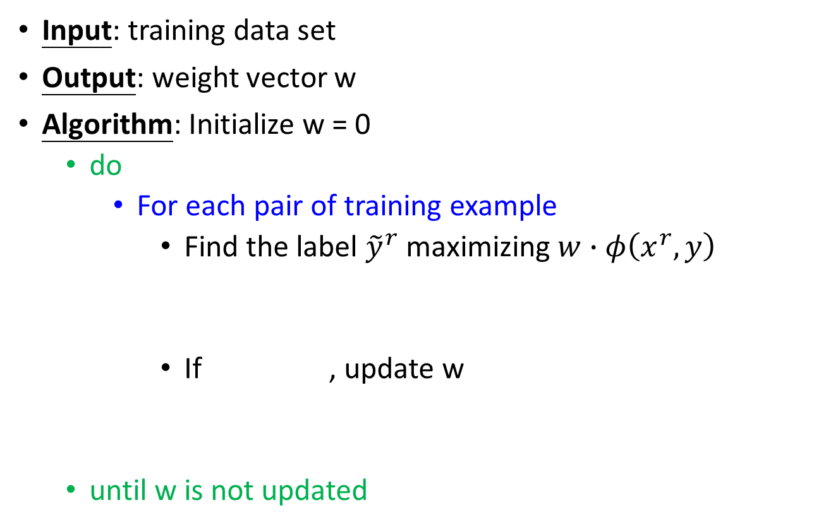
Algorithm
Will it terminate?
Input: training data set
Output: weight vector w
Algorithm: Initialize w = 0
do
For each pair of training example
Find the label ${\tilde{y}}^{r}$ maximizing $w∙φ\left(x^{r},y\right)$
If , update w
until w is not updated
(question 2)
We are done!
Notes:
Question 1 and 2 is solved.
Important: if the weight if not update, end the algorithm

Slide 15




Algorithm - Example
$${\hat{y}}^{1}$$
$$x^{1}$$
$${\hat{y}}^{2}$$
$$x^{2}$$

Slide 16
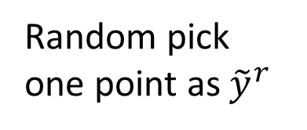
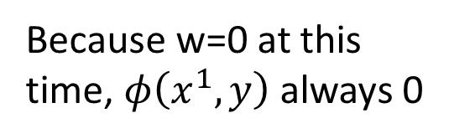
Algorithm - Example
Initialize w = 0
pick
If , update w
Because w=0 at this time, $φ\left(x^{1},y\right)$ always 0
Random pick one point as ${\tilde{y}}^{r}$

Slide 17
Algorithm - Example
pick
If , update w

Slide 18
Algorithm - Example
pick again
do not update w
pick again
do not update w
So we are done

Slide 19

Assumption: Separable
There exists a weight vector $\hat{w}$
(All training examples)
(All incorrect label for an example)
(The target exists)
Notes:
Assumption: Separable 假设:可分

Slide 20
Assumption: Separable

Slide 21
Proof of Termination
w is updated once it sees a mistake
(the relation of w^{k} and w^{k-1})
Proof that:
The angle ρ_{k} between and w_{k} is smaller as k increases
Analysis
(larger and larger?)
(Separable)
Notes:
Proof of Termination 终止证明

Slide 22
Proof of Termination
w is updated once it sees a mistake
(the relation of w^{k} and w^{k-1})
Proof that:
The angle ρ_{k} between and w_{k} is smaller as k increases
Analysis
(larger and larger?)
=0
≥δ
(so what)
Notes:
It is not update every time (some of them is not updated when seeing the enough examples)

Slide 23
Proof of Termination
?
(mistake)
Assume the distance between any two feature vector is smaller than R
Notes:
X = a + b
||x||2 = (a+b)T(a+b) = (aT + bT) (a + b)
= aTa + bTb + 2 a dot b

Slide 24
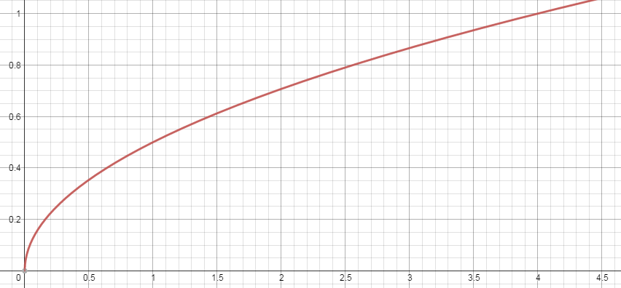
Proof of Termination

Slide 25
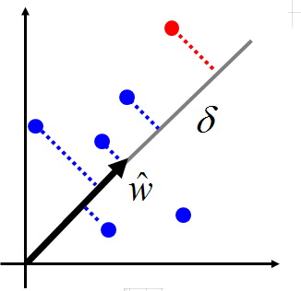
Proof of Termination
The largest distances between features
Normalization
Margin: Is it easy to separable red points from the blue ones
Larger margin, less update
All feature times 2

Slide 26
Structured Linear Model: Reduce 3 Problems to 2
Problem 1: Evaluation
How to define F(x,y)
Problem 2: Inference
How to find the y with the largest F(x,y)
Problem 3: Training
How to learn F(x,y)
F(x,y)=w·φ(x,y)
Problem A: Feature
How to define φ(x,y)
Problem B: Inference
How to find the y with the largest w·φ(x,y)

